Slide 1
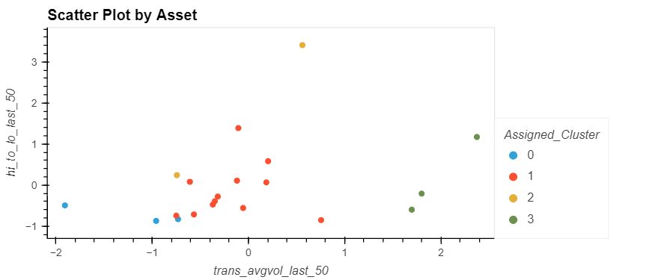
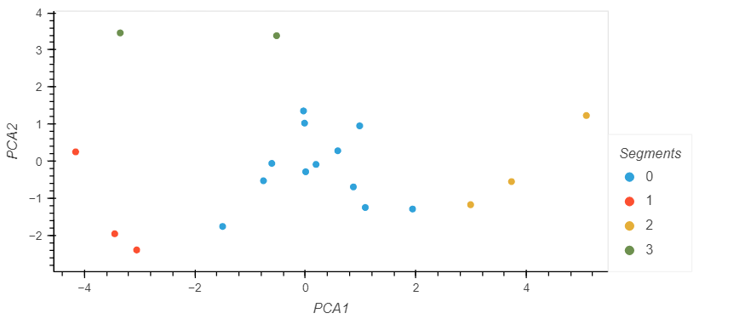
K-Means
Tesla,
Volatility
US Banks, FAANGs, etc
Bitcoin, Nasdaq,
S&P
Crude, US Dollar, Treasuries
PCA
Tesla,
Volatility
US Banks, FAANGs, etc
Crude, US Dollar, Treasuries
Bitcoin, Nasdaq,
S&P

Slide 3
Created three logistic regression models to predict if Bitcoin will outperform it’s historical median 50-day return over the next 50 days:
Model 1 - Historical Trading
Used historical trading metrics (over the past 1, 5, 15, and 50 days):
Volume
Return
Price Volatility
Model 2 - Additional Features
Incorporated additional features including:
Consumer Sentiment Index (CSI)
Gallup Institutional (president, police, banks, big business) Trust Polling
Consumer Price Index (CPI)
US GDP
Crypto Tweet Sentiment Analysis
Model 3 - Lower Threshold
Lowered the decision threshold in order to increase ‘positive’ scenarios at the expense of some predictive accuracy (resulting in higher volume of ‘positive’ trades with lower accuracy)

Slide 4
Many more ‘positives’ detected at the cost of only slightly lower ‘positive’ accuracy
Additional features in Model 2 do not provide any lift in predictive power…

